Slide 1
Chapter 2
2-4

Slide 2
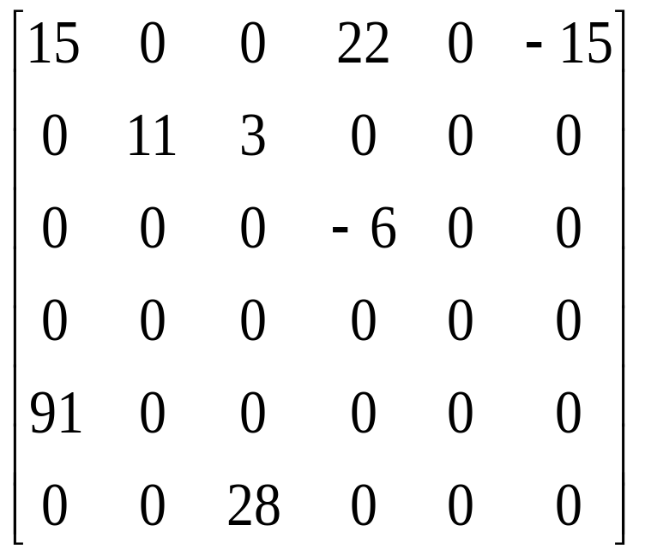
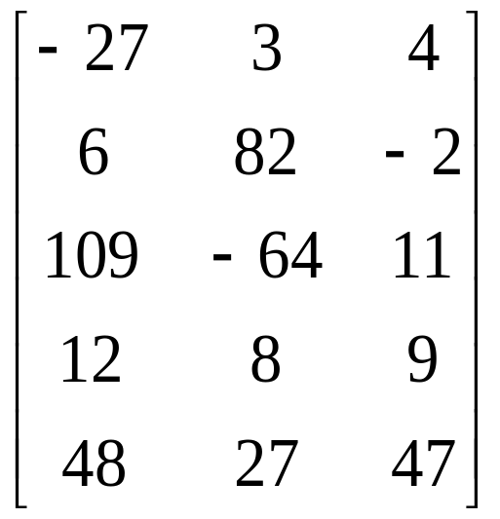
Sparse Matrices

Slide 3
ADT 2.3 Abstract data type SparseMatrix
class SparseMatrix
// objects: A set of triples, <row, column, value>, where row and column are integers
// and form a unique combinations; value is also an integer. */
public:
SparseMatrix(int MaxRow, int MaxCol);
// the constructor function creates a SparseMatrix that can hold up to
// MaxInterms = MaxRow x MaxCol and whose maximum row size is MaxRow
// and whose maximum column size is MaxCol
SparseMatrix Transpose();
// returns the SparseMatrix obtained by interchanging the row and column value
// of every triple in *this

Slide 4
ADT 2.3 Abstract data type SparseMatrix (cont.)
SparseMatrix Add(SparseMatrix b);
// if the dimensions of a (*this) and b are the same, then the matrix produced by
// adding corresponding items, namely those with identical row and column
// values is returned
// else error.
SparseMatrix Multiply(SparseMatrix b);
// if number of columns in a (*this) equals number of rows in b then the matrix d
// produced by multiplying a by b according to the formula d[i][j] =
// Σ(a[i][k] . b[k][j]), where d[i][j] is the (i, j)th element, is returned. k ranges from 0
// to the number of columns in a – 1
// else error
};

Slide 5
Sparse Matrix Representation
Use triple <row, column, value>
Store triples row by row
For all triples within a row, their column indices are in ascending order.
Must know the number of rows and columns and the number of nonzero elements

Slide 6
Sparse Matrix Representation (Cont.)
class SparseMatrix; // forward declaration
class MatrixTerm {
friend class SparseMatrix
private:
int row, col, value;
};
In class SparseMatrix:
private:
int Rows, Cols, Terms;
MatrixTerm smArray[MaxTerms];

Slide 7
Sparse Matrix Representation
(example)
row col value
smArray[0] 0 0 15
[1] 0 3 22
[2] 0 5 -15
[3] 1 1 11
[4] 1 2 3
[5] 2 3 -6
[6] 4 0 91
[7] 5 2 28
15 0 0 22 0 -15
0 11 3 0 0 0
0 0 0 -6 0 0
0 0 0 0 0 0
91 0 0 0 0 0
0 0 28 0 0 0

Slide 8
Transposing A Matrix
Intuitive way:
  for (each row i)
  take element (i, j, value) and store it in (j, i, value) of the transpose
More efficient way:
  for (all elements in column j)
  place element (i, j, value) in position (j, i, value)

Slide 9
Program 2.10 Transposing a Matrix
SparseMatrix SparseMatrix::Transpose()
// return the transpose of a (*this)
{
SparseMatrix b;
b.Rows = Cols; // rows in b = columns in a
b.Cols = Rows; // columns in b = rows in a
b.Terms = Terms; // terms in b = terms in a
if (Terms > 0) // nonzero matrix
{
int CurrentB = 0;

Slide 10
Program 2.10 Transposing a Matrix (cont.)
for (int c = 0; c < Cols; c++) // transpose by columns
for (int i = 0; i < Terms; i++)
// find elements in column c
if (smArray[i].col == c) {
b.smArray[CurrentB].row = c;
b.smArray[CurrentB].col = smArray[i].row;
b.smArray[CurrentB].value = smArray[i].value;
CurrentB++;
}
} // end of if (Terms > 0)
} // end of transpose
O(terms*columns)

Slide 11
Fast Matrix Transpose
The O(terms*columns) time => O(rows*columns²) when terms is the order of rows*columns
A better transpose function in Program 2.11. It first computes how many terms in each columns of matrix a before transposing to matrix b. Then it determines where is the starting point of each row for matrix b. Finally it moves each term from a to b.

Slide 12
Program 2.11 Fast Matrix Transposing
SparseMatrix SparseMatrix::Transpose()
// The transpose of a(*this) is placed in b and is found in Q(terms + columns) time.
{
int *Rows = new int[Cols];
int *RowStart = new int[Rows];
SparseMatrix b;
b.Rows = Cols; b.Cols = Rows; b.Terms = Terms;
if (Terms > 0) // nonzero matrix
{
// compute RowSize[i] = number of terms in row i of b
for (int i = 0; I < Cols; i++) RowSize[i] = 0; // Initialize
for ( I = 0; I < Terms; I++) RowSize[smArray[i].col]++;
O(columns)
O(terms)

Slide 13
Program 2.11 Fast Matrix Transposing (Cont.)
// RowStart[i] = starting position of row i in b
RowStart[0] = 0;
for (i = 0; i < Cols; i++) RowStart[i] = RowStart[i-1] + RowSize[i-1];
for (i = 1; I < Terms; i++) // move from a to b
{
int j = RowStart[smArray[i].col];
b.smArray[j].row = smArray[i].col;
b.smArray[j].col = smArray[i].row;
b.smArray[j].value = smArray[i].value;
RowStart[smArray[i].col]++;
} // end of for
O(columns-1)
O(terms)

Slide 14
Program 2.11 Fast Matrix Transposing (Cont.)
} // end of if
delete [ ] RowSize;
delete [ ] RowStart;
return b;
} // end of FastTranspose
O(row * column)

